Slide 1


MOBILE APPLICATION DEVELOPER
Github Client
usth
2024
USER INTERFACE SIMULATION
MIDTERM PROJECT

Slide 2


OUR TEAM
Mobile Application Developer Group
ĐỖ CÔNG TUẤN HƯNG 22BI13181 ​
TÔ THANH HẢI 22BI13148 ​
TRỊNH ĐỨC ANH 22BI13043 ​
NGUYỄN ĐÌNH HẢI 22BI13146
PHẠM HOÀNG DƯƠNG 22BI13115​
NGUYỄN DŨNG 22BI13104​

Slide 3



Introduction
Github Client
Why?

Slide 4
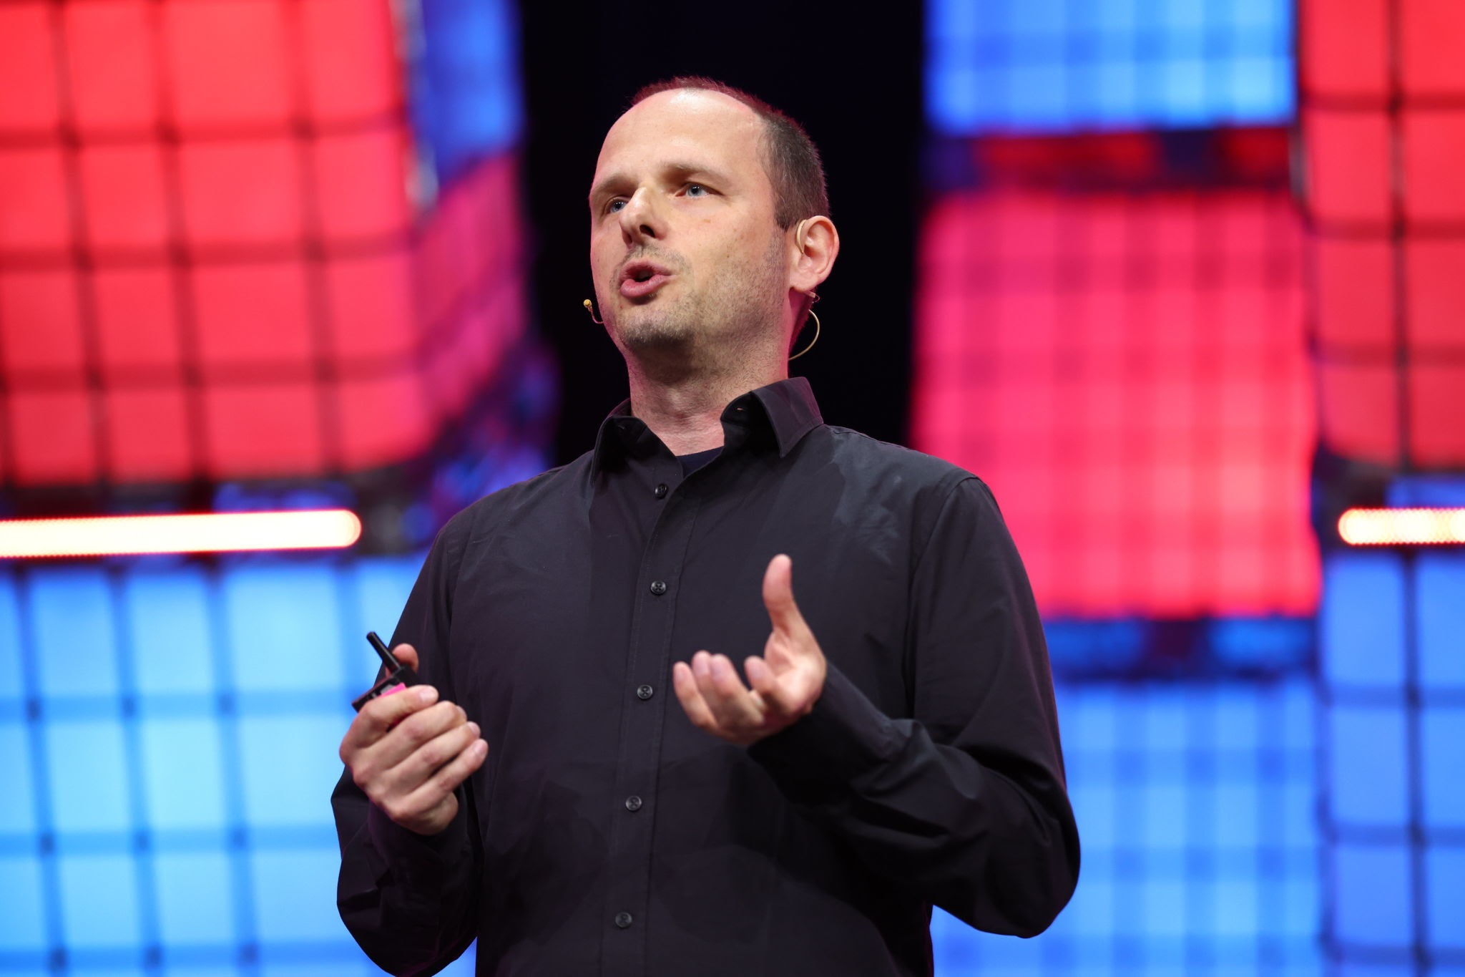

ACTIVITIES
PrimeActivity
Main Activity to execute the whole project
PagerAdapter
Connect fragments
Fragments
Fragments Design

Slide 5


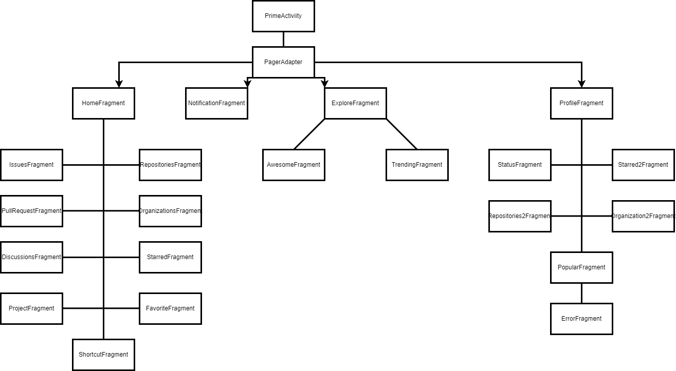
ARCHITECTURE
Layout

Slide 6

THE
DEMO

Slide 7



CONCLUSION
What we accomplished?
Future possibilities
What could be improved?

Slide 8

THANK YOU
FOR LISTENING

